Slide 1
Today’s Agenda
Overflow in four bit adder and subtractor .
Carry lookahead generator

Slide 2
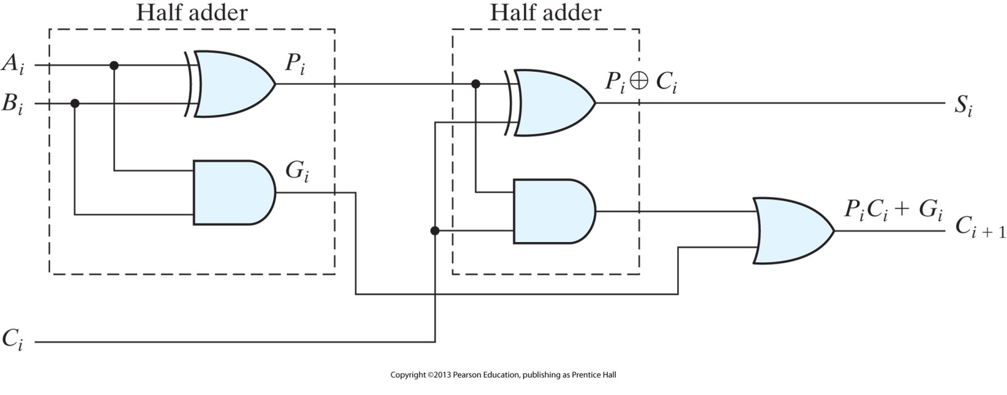
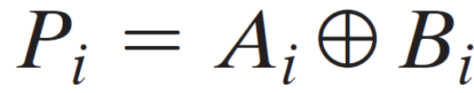

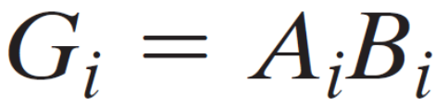
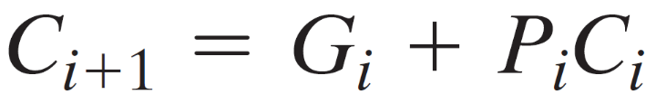
Carry Lookahead Generator
FA Adder with different labels for convenience
G_{i} = carry Generate. It produces a carry of 1 when both A_{i} and B_{i} =1
P_{i} = carry Propagate. It determines whether a carry from stage i will propagate into stage i + 1

Slide 3

Carry Lookahead Generator
Known Variables:
If C_{i} are known, then S_{i} is known
A_{i} , B_{i}
P_{i}
C_{i} can be found once expressed in known variables
G_{i}
I/p carry

Slide 4
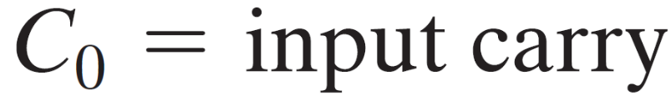
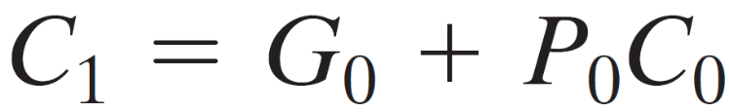
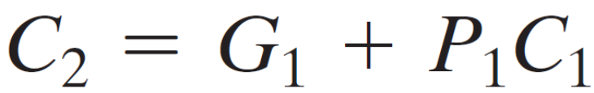
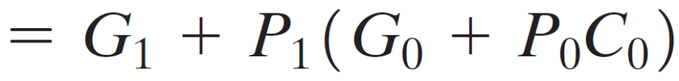
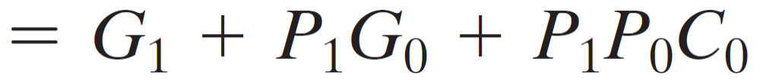
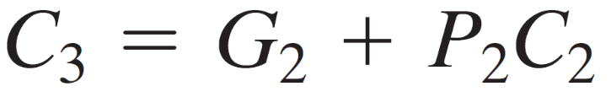
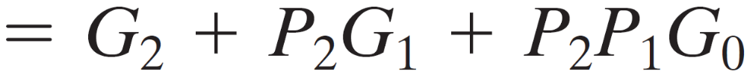
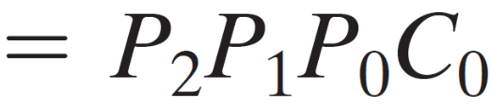
Carry Lookahead Generator

Slide 5
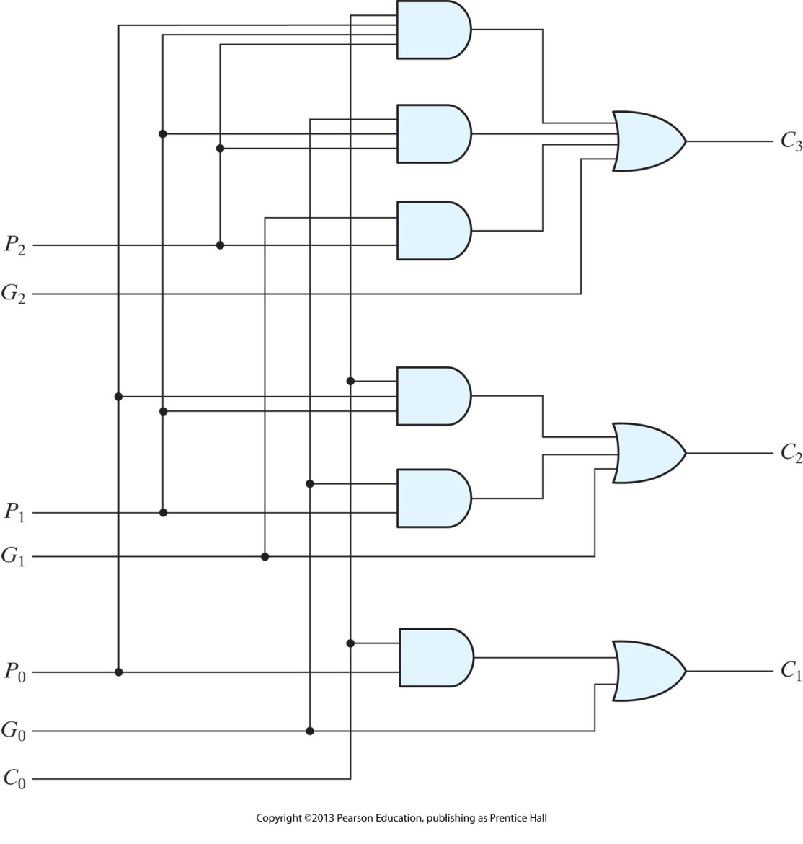
Carry Lookahead Generator
Carry Generator
P₂
G₂
C₃
C₂
C₁
P₁
G₁
P₀
G₀
C₀

Slide 6
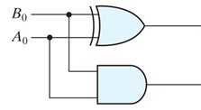

1-bit Adder with Carry Lookahead
Carry Generator
P₀
S₀
G₀
C₀
C₀

Slide 7
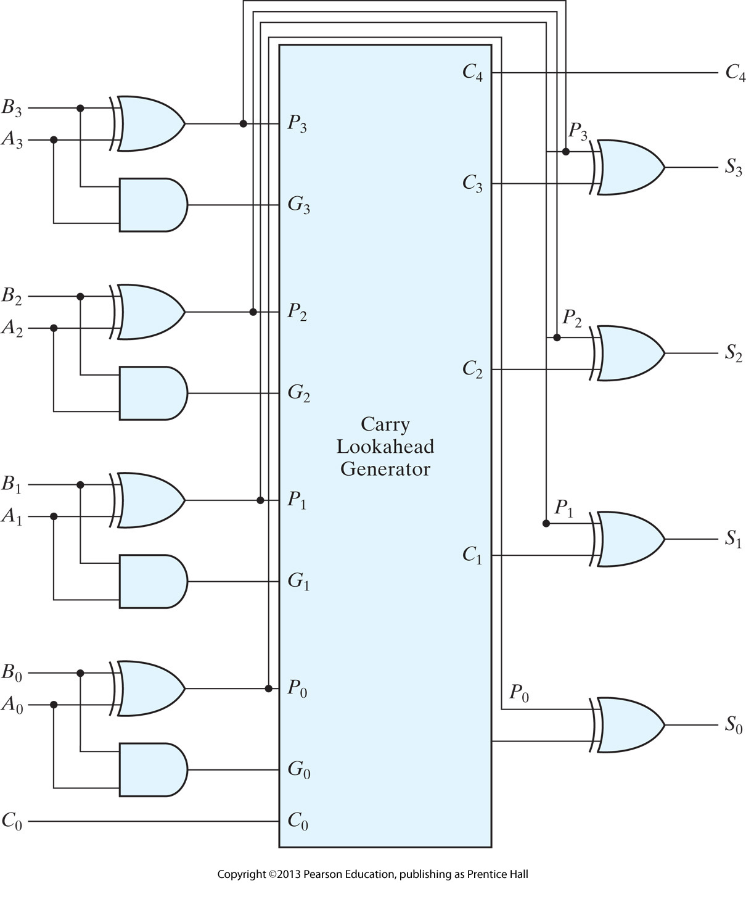

4-Bit Adder with Carry Lookahead
c₃ c₂ c₁ .
A₃ A₂ A₁ A₀
+ B₃ B₂ B₁ B₀
────────
C₄ S₃ S₂ S₁ S₀
Delay ↓↓↓
H/ware Complexity
↑↑↑

